Slide 1
Financial wellness

Slide 2
Overview
By the end of this workshop you should:
Have a basic foundation of the psychology of money
Be able to write financial goals using the SMART framework
Define your personal values and explain how values influence financial decision making
Be able to identify how external influences affect financial decision-making
Understand the importance of tracking your spending

Slide 3
SECTION 1 Psychology of money

Slide 4
Emotions of Money
What is your first money memory?
How does your first money memory dictate your relationship with money now?
How do you want to change your relationship with money?
How are you going to make that change happen?
What will your life look like if you change your relationship with money?

Slide 5
SECTION 2 Smart goals

Slide 6
Key Takeaway
Setting SMART goals helps you achieve your hopes and dreams for the future by providing a realistic plan to follow.

Slide 7
SMART Goals
To ensure your goals are… | Ask yourself…
Specific | What exactly do I want to accomplish? Why is this important to me? Is this something I really want?
Measurable | How much? How many? How will I know when I have met my goal?
Action-oriented | What specific actions do I need to complete to meet this goal?
Reachable | Is this goal something I can actually reach?
Time-bound | When will I reach this goal?

Slide 8
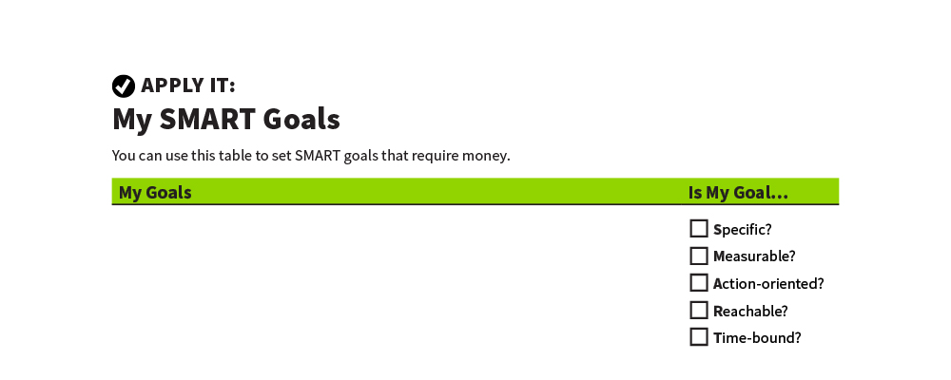
My SMART Goals
Apply It

Slide 9
SECTION 3 Using Your Values When Managing Your Money

Slide 10
Key Takeaway
Understanding your values can help you set achievable financial goals.

Slide 11
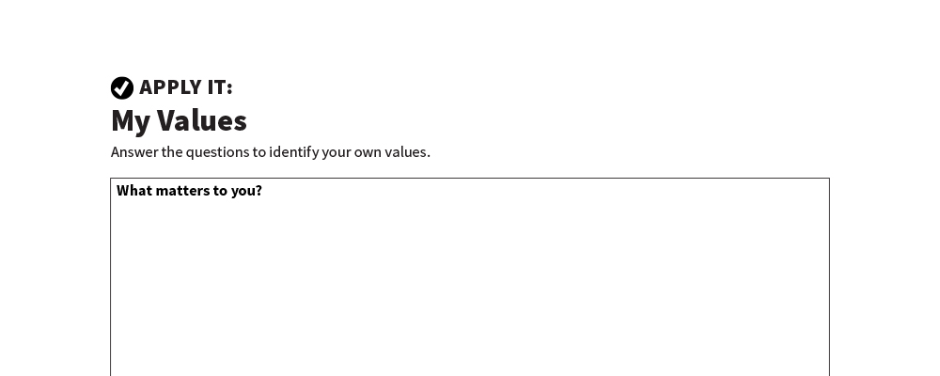
My Values
Apply It

Slide 12
Using Your Values When Managing Your Money
Understanding your core values can help you set realistic goals.
Understanding your core values can also help you make spending decisions that will help you meet your goals.

Slide 14
SECTION 4 External Influences on Choices About Money

Slide 15
Influences on Choices About Money
Friends and peers
Celebrities and athletes
Social media and influencers
Advertisements
Television and movies

Slide 16
Influences Can Be…
PRODUCTIVE
Helping you achieve your goals
UNPRODUCTIVE
Getting in your way

Slide 17
Social Pressure and Advertising
It is human nature to want what others have.
Advertisers spend money to influence how we spend our money.
Social media influencers work for brands to influence how you spend money.
Impulse purchases can make it harder to achieve goals.

Slide 18
Strategies for Staying Focused on Your Goals
Recognize tactics used by advertisers.
Build in a pause.
Control your environment
Notice when and where you are tempted.
Talk yourself out of it.
Calculate how many hours or days of work an item is worth.

Slide 19
SECTION 5 Money Diary

Slide 20
Key Takeaway
“Use your money as a tool and as a resource and glean as much joy out of it as you can”
~Tori Dunlop
Founder of Her First 100k

Slide 21
Spending Diary
The idea is to not stop spending money, but to make sure you are spending money on the things that move you towards your goals and best represents your values!
For one month (or longer) record every time you spend money. Record how much you spend, what you spent it on
Identify wants and needs
Lastly, identify how the spending made you feel.

Slide 22
SPARKPOINT INDIVIDUAL COACHING
Work on financial goals
Create a budget
Save money
Reduce your debt
Increase your credit score
Financial planning
And much more…

